Slide 1

Notes App
20XX
Python Flask backend with SQLite persistence

Slide 2
Introduction
This presentation outlines a concise backend plan for an online notes application built with Python, Flask, and SQLite.
Focus on simple RESTful endpoints, secure user handling, and reliable local persistence for fast prototyping and deployment.

Slide 3

01
Backend Design

Slide 4

Flask routes
Implement RESTful endpoints: /auth/login, /auth/register, /notes (GET, POST), /notes/id (GET, PUT, DELETE).
Use JSON requests/responses, input validation, and consistent error codes. Protect routes with session or token-based auth.

Slide 5
Database schema (SQLite)
Create tables: users(id, email, password_hash), notes(id, user_id, title, body, tags, updated_at), and tags(id, name) with join table for many-to-many.
Add indexes on user_id and updated_at for fast queries and simple migration strategy.

Slide 6
Authentication & authorization
Use token-based auth (JWT) or secure sessions with hashed passwords and salted storage.
Enforce route protection, input validation, and role checks for sensitive actions.
Implement rate limiting and optional 2FA for improved security and account recovery.

Slide 7
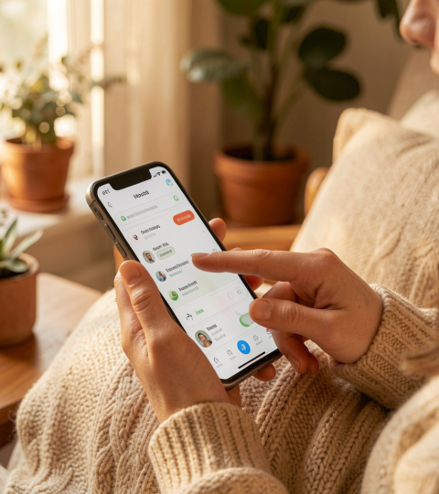
01
User Features

Slide 8
Notes CRUD operations
Provide REST endpoints for create, read, update, delete notes with JSON payloads.
Ensure ownership checks, optimistic concurrency (updated_at), and lightweight validation.

Slide 9
Search, tags, filtering
Support full-text search on title/body and tag-based filtering.
Use normalized tags or a join table; index searchable fields for performance.

Slide 10
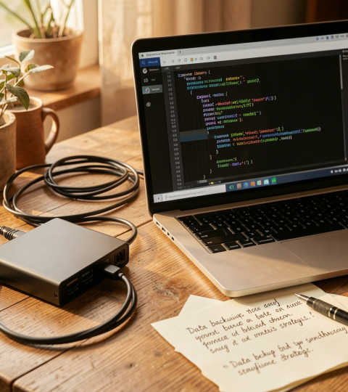
Sync, export, backups
Offer JSON export/import and periodic SQLite backups for disaster recovery.
Design simple sync by tracking last_modified per note and resolving conflicts by timestamp.

Slide 11
Conclusions
Keep backend minimal, secure, and testable for fast iteration.
Focus on clear APIs, reliable persistence, and simple user protections to enable future growth.

Slide 12
Thank you
Do you have any questions?
youremail@freepik.com
+00 000 000 000
yourwebsite.com
Please keep this slide for attribution

